Slide 1

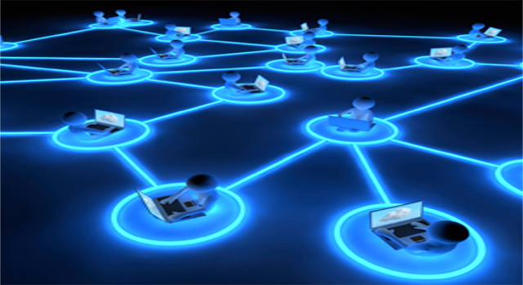
BIT 4101: Distributed Systems

Slide 2
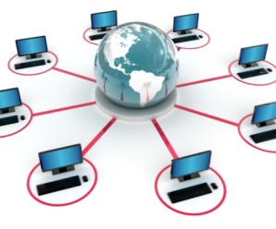
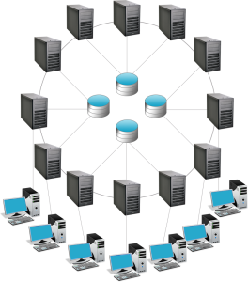
Fundamentals of Distributed Systems
What is a distributed system?
A distributed system is a collection of autonomous computers, connected through a network and distribution middleware, which enables computers to coordinate their activities and to share the resources of the system, so that users perceive the system as a single, integrated computing facility.

Slide 3
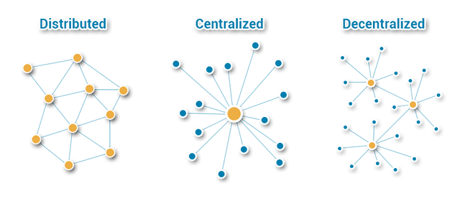
Centralized vs Distributed System
Centralized
Distributed
One component with non-autonomous parts
Component shared by users all the time
All resources accessible
Software runs in a single process
Single Point of control
Single Point of failure
Multiple autonomous components
Components are not shared by all users
Resources may not be accessible
Software runs in concurrent processes on different processors
Multiple Points of control
Multiple Points of failure

Slide 4
Examples of distributed systems
Telecommunication networks:
telephone networks & cellular networks
computer networks such as the Internet
wireless sensor networks
…etc

Slide 5
Characteristics of distributed system
Resource Sharing :Ability to use any hardware, software or data anywhere in the system
Openness : is concerned with extensions and improvements of distributed systems
Concurrency: Components in distributed systems are executed in concurrent processes
Scalability: Adaption of distributed systems to accomodate more users
Fault Tolerance: Hardware/software/network may fail!!! Distributed systems must maintain availability
Transparency: Distributed systems should be perceived by users and application programmers as a whole rather than as a collection of cooperating components

Slide 6
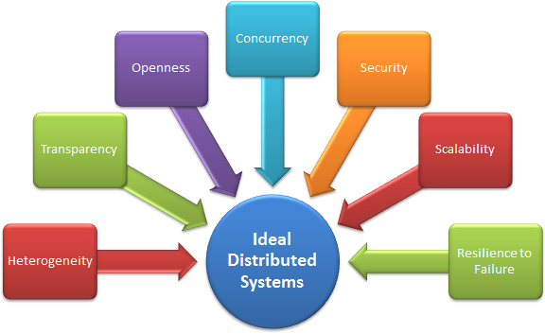

Slide 7
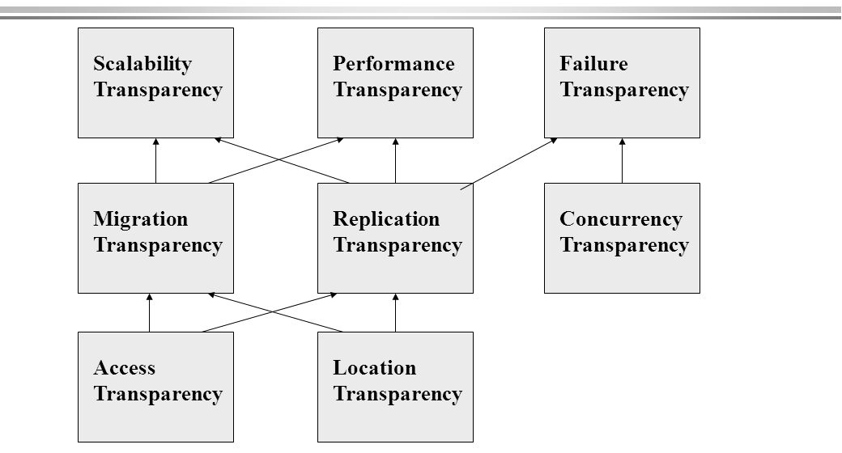
Dimensions of Transparency

Slide 8
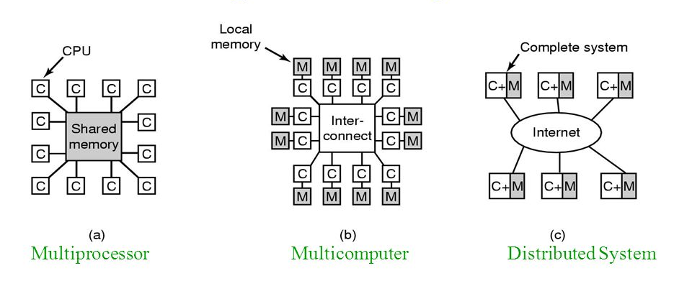
Distributed Systems: Hardware Concepts
Multiprocessor
Multicomputer

Slide 9
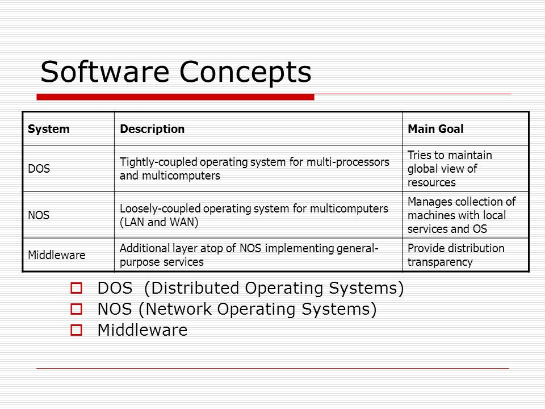
Distributed Systems: Software Concepts
DOS (Disk operating system)
NOS (Network Operating System)
Middleware

Slide 10
